Slide 1
PARKING LOT MANAGEMENT SYSTEM

Slide 2

NBKR INSTITUTE OF SCIENCE AND TECHNOLOGY a mini project by computer science and engineering department
Team members
N.VENNELA 24KB1A05CA
N.YASASWI 24KB1A05CB
N.HASWITHA 24KB1A05CC
O.BHAVANA 24KB1A05CJ

Slide 3
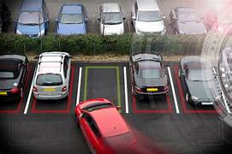
INTRODUCTION
The Parking Lot Management System is designed to manage vehicle parking efficiently using simple data structures.
Arrays are used to track parking slot availability, enabling fast allocation and status updates.
Linked lists maintain a dynamic history of parked vehicles, supporting easy insertions and deletions.
The system manages real-time vehicle entries and exits while keeping historical data intact.

Slide 4
OBJECTIVE
To develop an efficient system for managing parking slots in a structured and organized way.
To allocate and free parking slots in real-time using an array-based approach.
To maintain a historical log of all parked vehicles using linked lists for dynamic storage.
To reduce manual effort and errors in tracking vehicle movements in the parking lot.

Slide 5
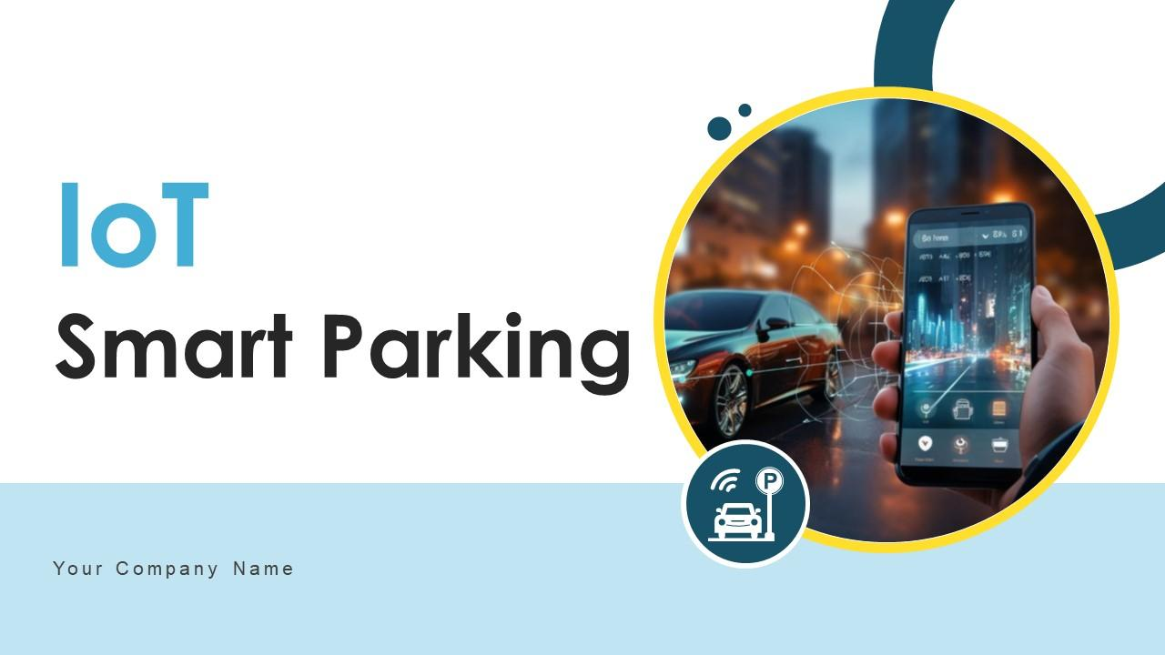
TECHNOLOGIES AND TOOLS
Programming Language: C
Data Structures: Arrays (for slot management) and Linked Lists (for vehicle history).
Compiler/IDE: Code::Blocks, Turbo C++, Eclipse, or any preferred development environment.
Operating System: Windows/Linux for code execution and testing.

Slide 6
ADVANTAGES
Efficient Slot Allocation: Helps manage and track slot availability instantly using arrays.
Easy Vehicle Tracking: License plates are stored and retrieved easily for parked vehicles.
Simple Implementation: Uses basic data structures like arrays and linked lists for simplicity.
Quick Operations: Vehicle parking, removal, and slot checks are done in constant time.

Slide 7
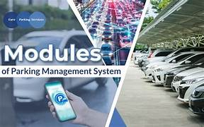
MODULES
Parking Slot Management Module – Handles allocation, deallocation, and tracking of parking slots using arrays.
Vehicle Entry Module – Records vehicle details and assigns available slots upon entry.
Vehicle History Module – Maintains a linked list log of all parked vehicles for reference.
User Interface Module – Provides interaction for users to view, enter, or remove vehicles.

Slide 8
CHALLENGES
Efficient Slot Allocation – Ensuring quick and accurate assignment of available parking slots in real-time.
Dynamic Vehicle History Management – Maintaining a growing linked list of parked vehicles without memory issues.
Concurrency Handling – Managing simultaneous vehicle entries and exits to avoid data inconsistency.

Slide 9
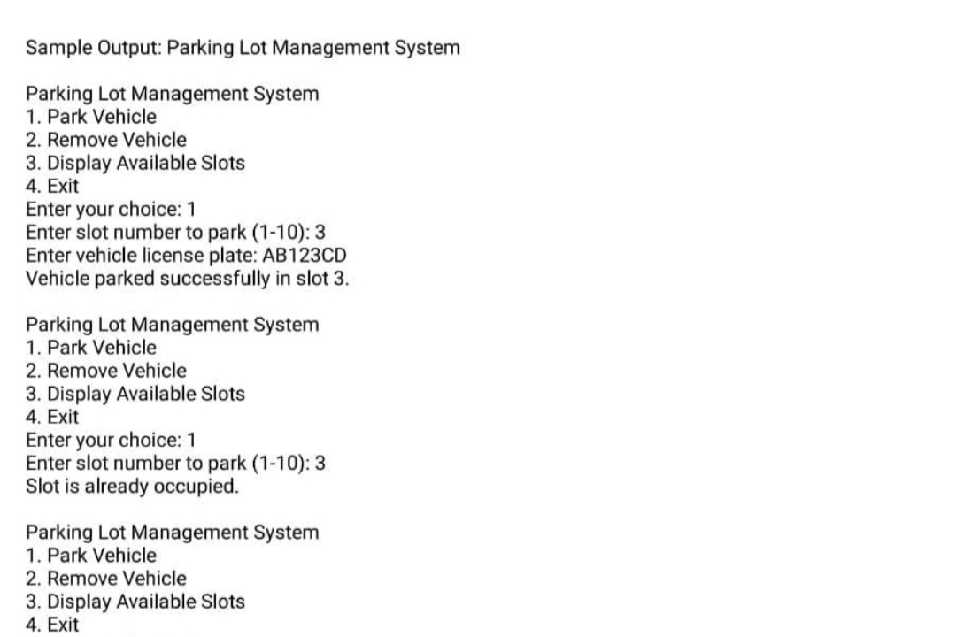
OUTPUT

Slide 10
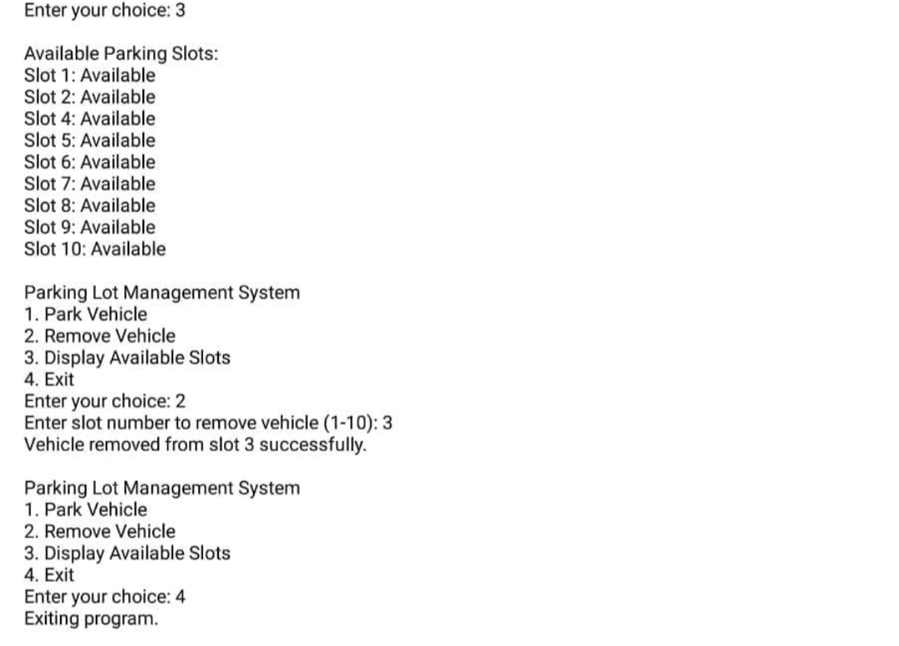

Slide 11
CONCLUSION
The Parking Lot Management System successfully demonstrates the application of arrays and linked lists in managing parking slots and vehicle history. By implementing efficient slot allocation and dynamic record management, the system streamlines vehicle entry, exit, and tracking. This project highlights the significance of using fundamental data structures to solve real-world management challenges, providing a scalable and effective solution.

Slide 12
THANK YOU…..

